Slide 1
Building Web Applications Using the Spring Framework

Slide 2



Rationale
When the requirement of a Web application is changed, the business logic needs to be changed.
The change in business logic affects the other components of the Web application as they are dependent on each other.
Therefore, to make the Web applications easily updatable, the components of the Web applications must be made loosely coupled.
The Spring framework enables the developers to create Web applications whose components are loosely coupled.

Slide 3
Objectives
In this session, you will learn to:
Identify the Spring framework
Identify the Spring architecture
Manage application objects

Slide 4
Introduction
Spring is the fresh new start after the winter of traditional J2EE
The Spring Framework provides a complete solution to most of the problems that occur in handling the development of numerous complex modules collaborating with each other in a Java enterprise application.
Spring is not a replacement for the traditional Java Development, but it is a reliable solution for companies to withstand in today's competitive and fast-growing market without forcing the developers to be tightly coupled on Spring APIs.

Slide 5
Problems addressed by Spring
Scalability
Plumbing code(Pipeline Code)
Boiler plate code
Unavoidable non-functional code
Unit testing of the application
POJO-based development
Loose coupling through the dependency injection
Declarative programming
Boilerplate code reduction using aspects and templates
Layered architecture

Slide 6

Features of Spring
Pluggability
Dependency Injection (DI)
Features of
Aspect -Oriented Programming (AOP)
Lightweight
Container

Slide 7

Just a Minute
Which one of the following features of Spring eliminates the need for code lookup, allows pluggability and reuse of existing code, and makes application maintenance and testing easy?
DI
AOP
Container
Lightweight
Answer:
1. DI

Slide 8
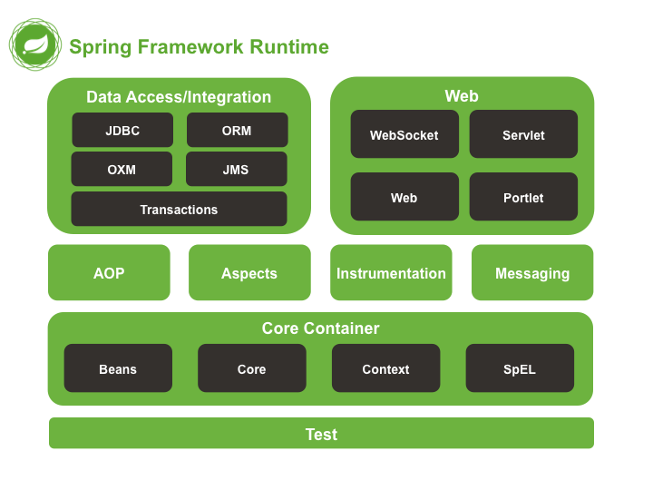
Introducing the Spring Architecture

Slide 9
Core
Provides the fundamental functionality of the Spring framework.
Contains the most important component of the Spring framework, the bean factory container.
Core
Requires you to use the org.springframework.core package within your Web application.
Applies DI to separate the object initialization, creation, and access from the actual application code.

Slide 10
DAO
Aims to standardize data access work through technologies, such as Hibernate, JDO, or JDBC.
Enables you to write simple database code without worrying about database related tasks.
DAO
Requires you to use the org.springframework.dao package within your Web application.
Provides an exception hierarchy for managing database connections and handling exceptions.

Slide 11
ORM
Enables developers to integrate the Spring framework with several other ORM tools.
Is built upon the DAO module to provide an easy way to build DAOs for the ORM tool.
ORM
Requires you to use the org.springframework.orm package within your Web application.
Is supported by the declarative transaction management services of the Spring framework.

Slide 12
AOP
Enables Spring to provide support for implementing aspects within your Web application.
Supports loose coupling of the application objects.
AOP
Requires you to use the org.springframework.aop package within your Web application.
Enables you to separate the application logic from the system-level services called cross-cutting concerns.

Slide 13
MVC
Provides a flexible Model -View-Controller implementation for creating Web applications.
Enables you to separate the model and application logic from the view or the application UI.
MVC
Requires you to use the org.springframework.web package within your Web application.
Enables you to integrate several other MVC frameworks, such as Struts, and WebWorks.

Slide 14
Application Context
Is built on top of the core module and provides you with the ability to obtain application resources.
Provides support for internationalization of messages, application lifecycle events, and validations.
Application Context
Requires you to use the org.springframework. context package within your Web application.
Provides various enterprise level services, such as JNDI access, EJB integration, email, remoting, and scheduling.

Slide 15
Web Context
Is a part of its Web application development stack, which also includes the MVC module.
Is built on top of the application context module and provides the context for creating Web-based applications.
Web Context
Requires you to use the org.springframework.web package within your Web application.
Supports integration of the Spring framework with various frameworks, such as Struts, WebWorks, and JSF.

Slide 16
Just a Minute
Which one of the following packages do you need to implement the MVC module in your Web application?
org.springframework.web
org.springframework.context
org.springframework.core
org.springframework.dao
Answer:
1. org.springframework.web

Slide 17


Task: Creating a Spring Application
Let us see how to create a Spring application.
Perform Task 1.1: Creating a Spring Application

Slide 18
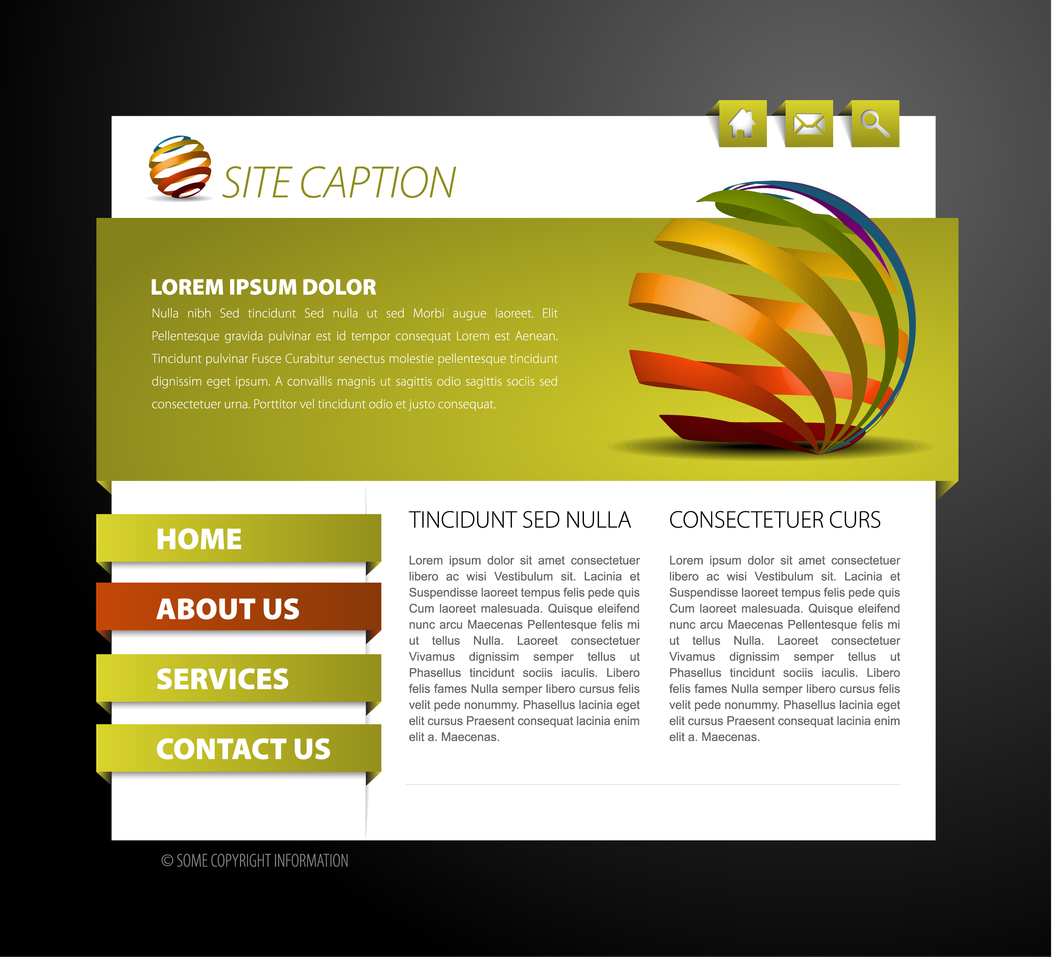
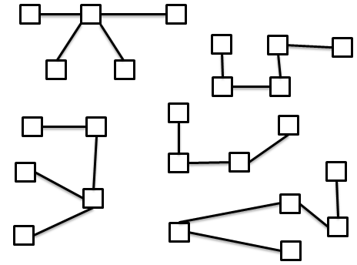
Managing Application Objects
Spring container
Dependency injection
Spring container
Injected into
Customer
Order
Product
Injected into

Slide 19
Managing Application Objects (Contd.)
Spring container
Bean Factory
Application Context

Slide 20
Introducing Bean Factory
Beans
Spring container
The objects created by the bean factory are fully configured, ready to use, and aware of their relationships with the other application objects.
The bean factory is involved in managing the life cycle of objects that have been created.
A bean factory is represented by the org.springframework.beans.factory.BeanFactory interface.
The most commonly used bean factory is the XML bean factory represented by the org.springframework.beans.factory.xml.XmlBeanFactory class.

Slide 21
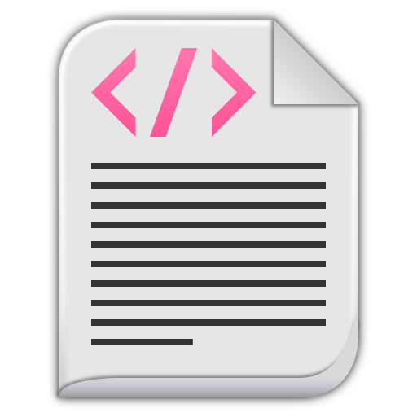
Introducing Bean Factory (Contd.)
XML Bean Factory
Bean configuration file
Syntax of a bean configuration file:
<?xml version="1.0" encoding="UTF-8"?>
<beans xmlns="http://www.springframework.org/schema/beans"
xmlns:xsi="http://www.w3.org/2001/XMLSchema-instance"
xsi:schemaLocation="http://www.springframework.org/schema/beans http://www.springframework.org/schema/beans/spring-beans-3.0.xsd
">
...
</beans>

Slide 22
Introducing Bean Factory (Contd.)
In a bean configuration file, each bean is defined by using the <bean> tag within the <beans> tag.
A bean definition contains the basic information about a bean that a container must know, such as the process for creating a bean, details about the bean life cycle, and the various dependencies for that bean.
Attributes of the <bean> tag
id
name
class
scope
Used to uniquely identify a bean in the Spring container.
Used to specify an alias name for the bean.
Used to specify the fully-qualified (package name + class name) name of the bean class.
Used to define the scope of the bean being defined.

Slide 23
Introducing Bean Factory (Contd.)
Example: Bean declaration
<?xml version="1.0" encoding="UTF-8"?>
<beans xmlns="http://www.springframework.org/schema/beans"
xmlns:xsi="http://www.w3.org/2001/XMLSchema-instance"
xsi:schemaLocation="http://www.springframework.org/schema/beans http://www.springframework.org/schema/beans/spring-beans-3.0.xsd
">
<bean id=“order” class=“com.techtails.Order"/>
</beans>

Slide 24
Introducing Bean Factory (Contd.)
To instantiate a bean factory in your Web application, you first need to load the bean configuration file.
This can be done by using the Resource object, defined by the org.springframework.core.io.Resource interface.
Depending upon the place from where the bean configuration file is to be loaded, the Spring framework provides several implementations of the Resource interface.
Bean scopes
Singleton
Prototype
Provides a shared instance of the bean with a particular name and places it in the factory.
Provides a single instance of a bean and guarantees that a user request will result in the creation of an independent bean for a single user only.

Slide 25
Introducing Bean Factory (Contd.)
You can retrieve an instance of a bean registered under a given name from the bean factory by using the getBean() method.
This method takes the ID of the bean as a string value.
Bean instantiation
Example:
Resource resource = new ClassPathResource(“applicationContext.xml”);
Beanfactory factory = new XmlBeanFactory(resource);
Order order = (Order)factory.getBean(“order”);
When the getBean() method is called, the bean factory container instantiates the bean and set its properties through DI.
After this, the life of the bean begins inside the Spring container.

Slide 26
Just a Minute
Which one of following attributes is used to uniquely identify a bean in the Spring container?
name
id
scope
class
Answer:
2. id

Slide 27
Introducing Application Context
Provides a means for resolving text messages, including support for internationalization of those messages.
Provides a generic way to load file resources, such as images.
Publishes events to beans, which are registered as listeners.
Application Context
ClassPathXmlApplicationContext
FileSystemXmlApplicationContext
Application context container

Slide 28
Introducing Application Context (Contd.)
If you want to use the application context container for managing your application objects, then you have to load a particular ApplicationContext implementation.
Loading the application context
Example: ClassPathXmlApplicationContext
ApplicationContext appContext = new ClassPathXmlApplicationContext(“applicationContext.xml");
Example: FileSystemXmlApplicationContext
ApplicationContext appContext = new FileSystemXmlApplicationContext("c:/Sport/applicationContext.xml");

Slide 29
Just a Minute
Which implementation of the application context container is used to load the bean configuration file located at the specified class path?
XmlApplicationContext
XmlWebApplicationContext
ClassPathXmlApplicationContext
FileSystemXmlApplicationContext
Answer:
3. ClassPathXmlApplicationContext

